Slide 1
Unit Testing in React.js
Presented by
RAGUNANTHAN Thangavel

Slide 2
Contents
In this session, we will explore
Benefits of unit testing
Setting up a unit testing environment
Writing unit tests using popular frameworks and
Best practices to follow

Slide 3
Difference between Manual testing and Automated testing?

Slide 4
Manual Testing
Manual testing is the process in which QA analysts execute tests one-by-one in an individual manner.
Manual testing can be time-consuming and labor-intensive.
The purpose of manual testing is to catch bugs and feature issues before a software application goes live.

Slide 5
Automated Testing
In automation testing, test cases are executed using automated tools and scripts.
Automation testing aims to reduce manual effort, increase test coverage, improve accuracy, and accelerate the overall testing process.
Automated test scripts can be reusable, as they are designed to perform specific actions and validations repeatedly.

Slide 6
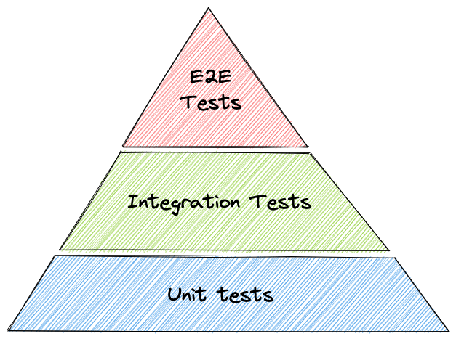

Slide 7
Unit Testing
Unit Testing is a type of software testing in which a small piece of code is tested to see if the code works as expected.
The goal of Unit testing is to help reduce the cost of bug fixes, as this way, bugs or errors in the code level are identified early in the development lifecycle.
For Unit Testing, accessibility of code is required, as it tests the written code.

Slide 8
Integration Testing
Integration testing, as its name implies, verifies that the interface between two software units or modules works correctly.
It is usually carried out after Unit Testing but before the overall system testing
The goal of integration testing is to find defects in communication between two modules rather than seeing if modules are working correctly.
Integration Testing, access to code is not required, since it tests the interactions and interfaces between modules.

Slide 9
End to End Testing
End-to-end testing is the type of software testing used to test entire software from starting to the end along with its integration with the external interfaces.
End-to-end testing ensures that all components of an application work together as expected, thereby providing comprehensive testing coverage.
It helps to identify issues that may not be detected in other forms of testing.

Slide 10
What to test ?
Test component renders
Test component renders with props
Test component renders in different state
Test component reacts to events

Slide 11
What not to test ?
Implementation details
Third party libraries

Slide 12
THANK YOU

